Slide 1
UFO Sighting Report
Jinwei(Edward) Kang

Slide 2
Introduction
Hundreds of reports of sighting UFO every year
We do not have conclusive evidence to prove aliens exist
Creating a model of predcting the month of UFO apperance

Slide 3
Data
Consolidated UFO and Weather Data
51,871 reports of UFO sightings from 1997 to 2017 in 8845 cities
Information about color, shape, and duration of every UFO sightings
Historical weather data for every day from 1997 to 2017 such as pressure, temperature, humanity, dew point, wind direction, wind speed, visibility.
Census Bureau API
Population and population density data of 50 States

Slide 4
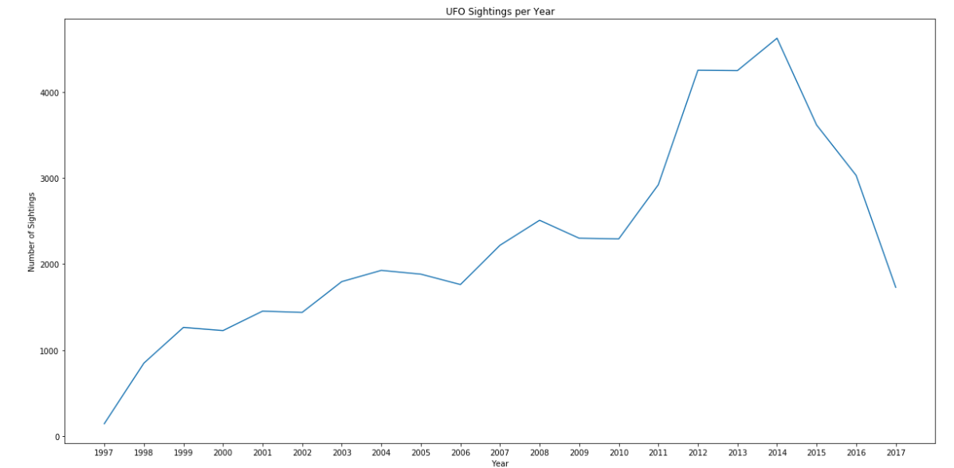
Trend of Yealy UFO Sighting
The number of UFO sighting has an upward trend from 1997 till 2014
2014 was the year recorded sighting the most UFOs
The number of UFO sighting started decreasing after 2014

Slide 5
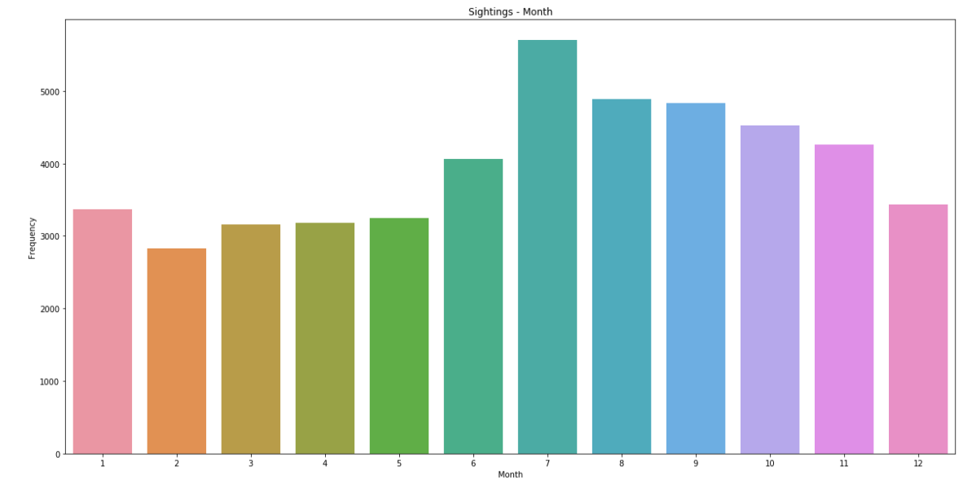
Montly UFO Sighting Rate
In a year period, summer and fall seasons have higher a frequency of UFO sighting

Slide 6
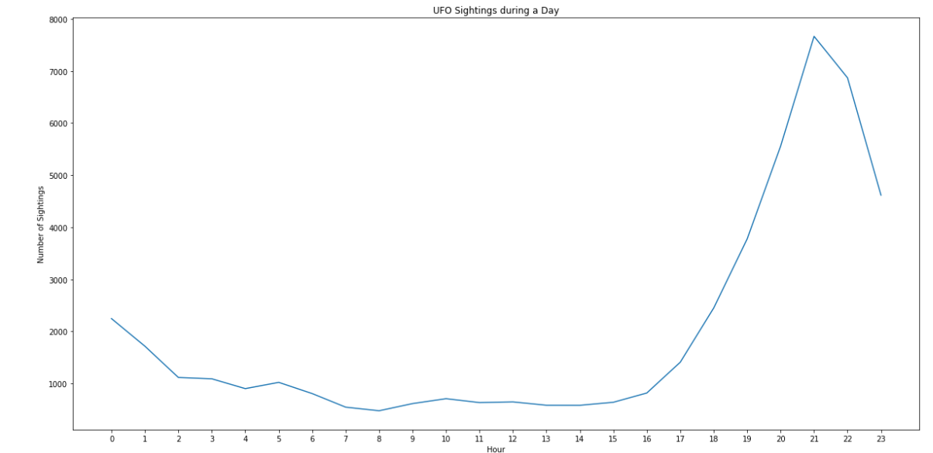
Daily UFO Sighting Trend
UFO sightings mostly happened during night time from 6 p.m. to 12 a.m
The trend starts to drop down after 12 a.m

Slide 7
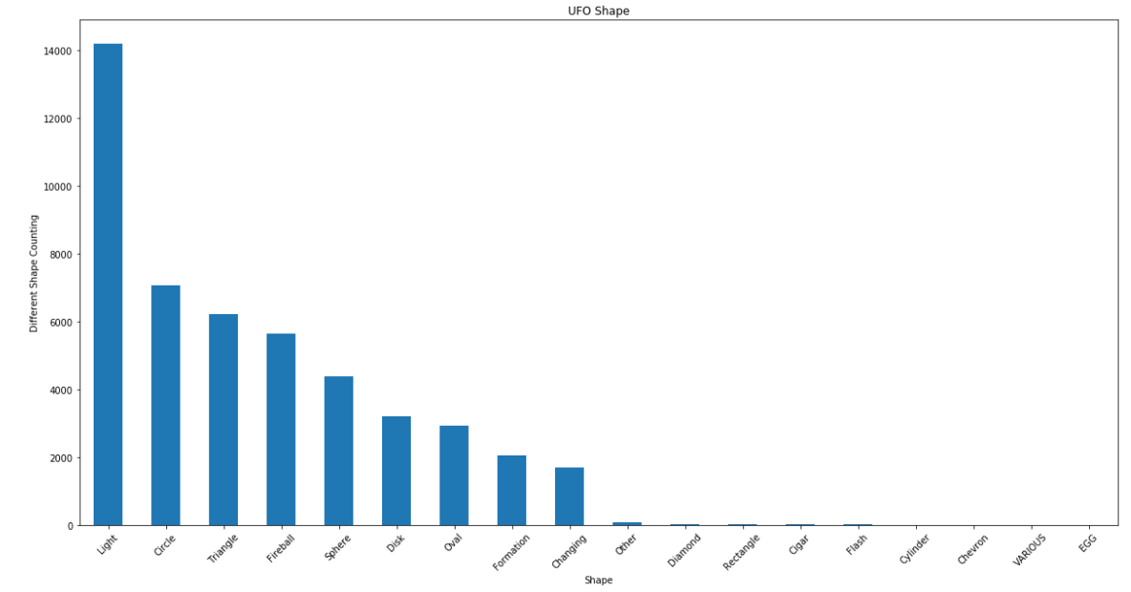
UFO Sighting Shape
In about 14,000 of 51,871 reports, the shape of the UFO is light
The second most common shape is circular，about 700 reports

Slide 8
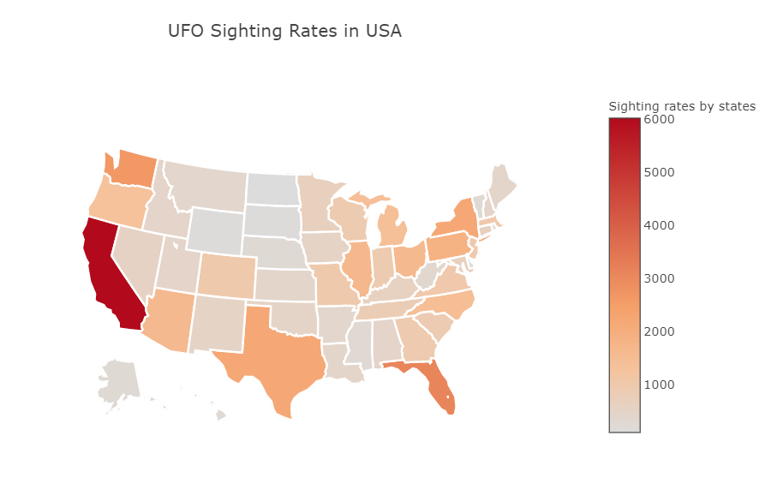
UFO Sighting Rate for States
California has the highest UFO sighting rate, there are over 6,000 reports
The next highest is in Florida, which there are about 4,000 reports.

Slide 9
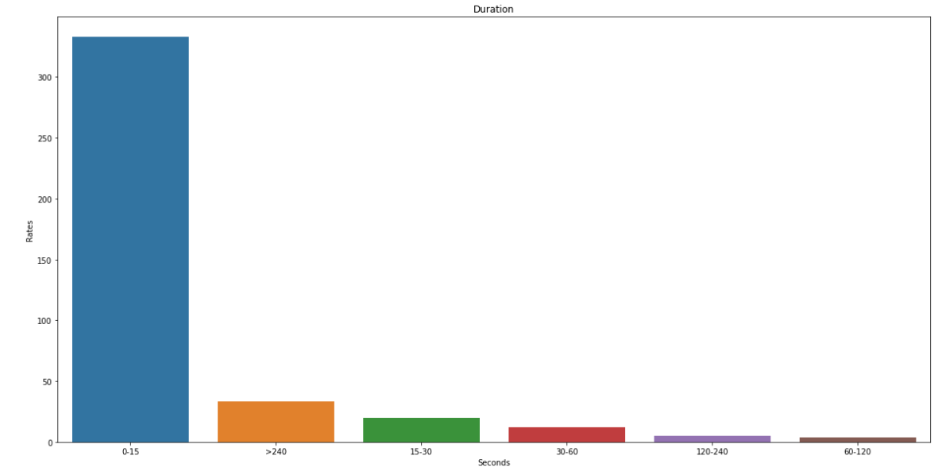
UFO Duration
Over 300 reports of UFO sighting only last zero to fifteen seconds.
The second highest rates of UFO sighting last for over 240 seconds.

Slide 10
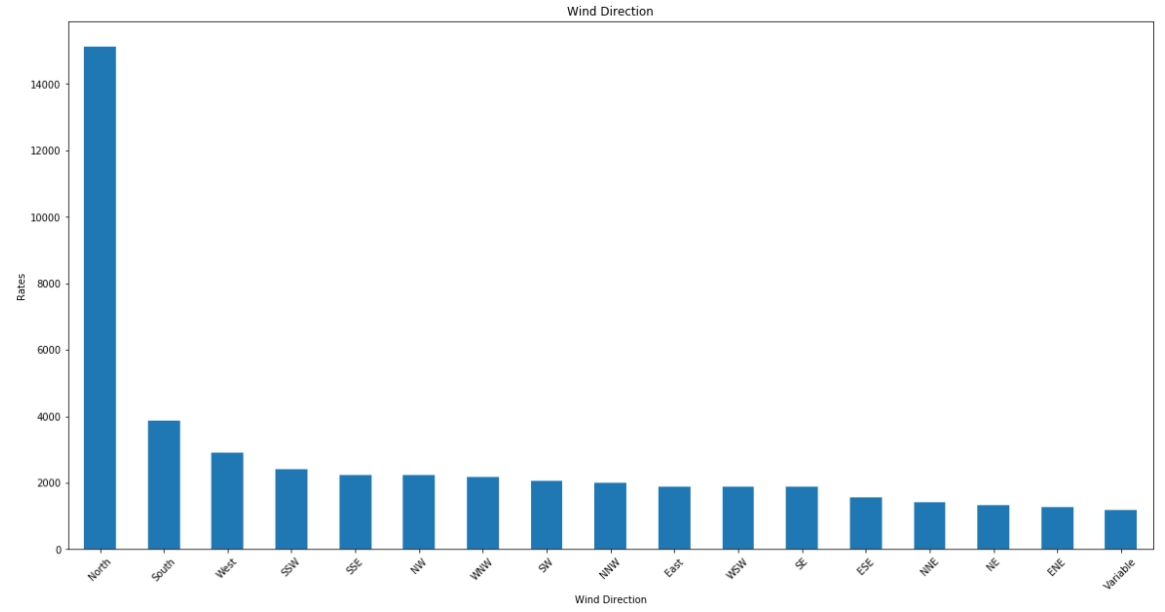
Wind Direction of UFO Sighting
Surprisingly, UFO sighting happened heavily during north wind weather.

Slide 11
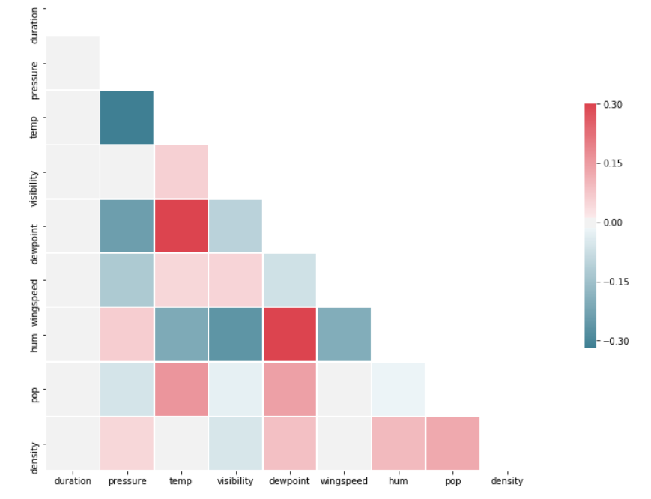
Duaration Correlation Heatmap
There is no correlation relationship between duration and the weather and population variables.

Slide 12
Predictive Model
Predictive model to predict the month of UFO appearance
Binary classification model base on UFO shape, State, hour, day, year, duration, pressure, temperature, visibility, dew point, wind speed, wind direction, weather condition, humanity, population, and population density
Class 1: UFOs appear on January to June
Class 0: UFOs appear on July to December

Slide 13
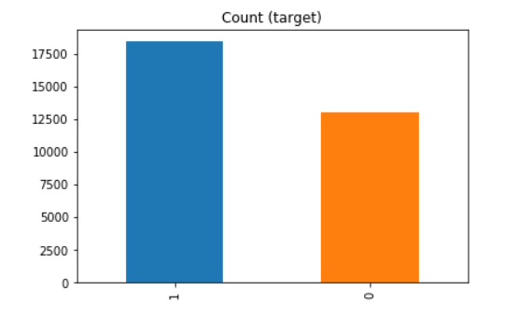
Two Classes
Class 1 has 18403 rows of data
Class 0 has 13015 rows of data
Two classes are close to balance

Slide 14
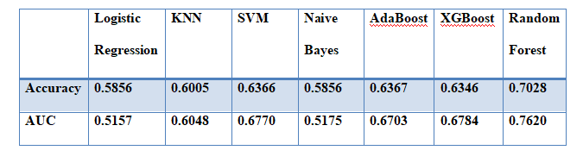
Algorithms Selection
70% of the data for training the model
30% of the data for testing the model performance
Random forest has the best accuracy and AUC score

Slide 15
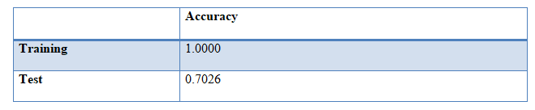
Overfitting Problem
Training data accuracy score is much higher than the test data accuracy score
Need to adjust

Slide 16
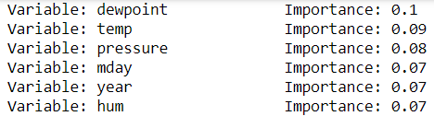
Features Selection
Irrelevant features can negatively impact model performance
Selected the top 6 most important variables

Slide 17
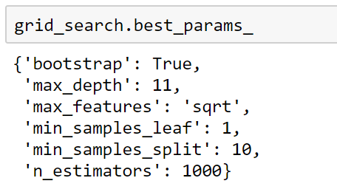
Hyperparameters Tuning
Random Search
Grid Seach
Picked the best hyperparameters

Slide 18
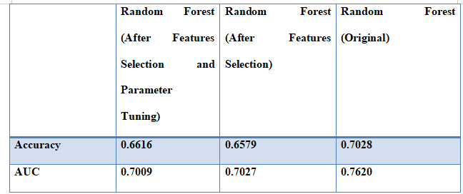
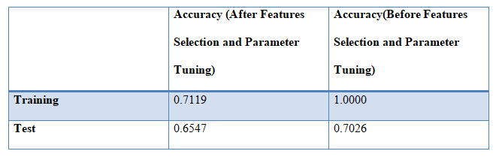
Final Result
Lower accuracy and AUC score after features selection and parameter tuning
Accuracy: 0.6616
AUC: 0.7009
Model did not overfitted

Slide 19
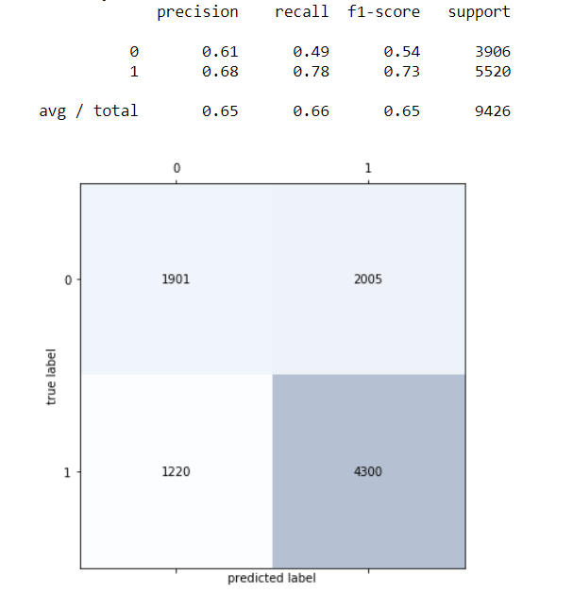
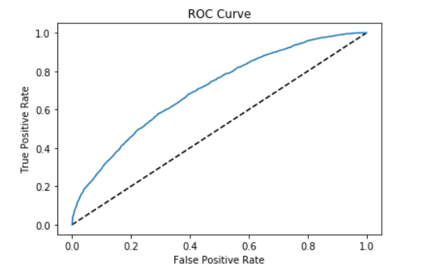
Conclusion
Model does not perform well for the true negative
Low recall score for the 0 class
Adding more class 0 data can imporve the model prediction

Slide 20
THANK YOU

